Slide 1
Capstone Project - 3
Team 4: Predicting the News
Popularity in
Multiple Social Media Platforms

Slide 2

Content
The Problem Statement
The EDA
Text Processing
Preparing Dataset
Model Evaluation
Future Work

Slide 3

Problem Statement
This is a large data set of news items and their respective social feedback on multiple platforms: Facebook, Google+ and LinkedIn.The collected data relates to a period of 8 months, between November 2015 and July 2016, accounting for about 100,000 news items on four different topics: Economy, Microsoft, Obama and Palestine.

Slide 4
Data Encapsulation
IDLink (numeric): Unique identifier of news items
Title (string): Title of the news item according to the official media sources
Headline (string): Headline of the news item according to the official media sources
Source (string): Original news outlet that published the news item
Topic (string): Query topic used to obtain the items in the official media sources
PublishDate (timestamp): Date and time of the news items' publication
SentimentTitle (numeric): Sentiment score of the text in the news items' title
SentimentHeadline (numeric): Sentiment score of the text in the news items' headline
Facebook (numeric): Final value of the news items' popularity according to the social media source Facebook
GooglePlus (numeric): Final value of the news items' popularity according to the social media source Google+
LinkedIn (numeric): Final value of the news items' popularity according to the social media source LinkedIn

Slide 5
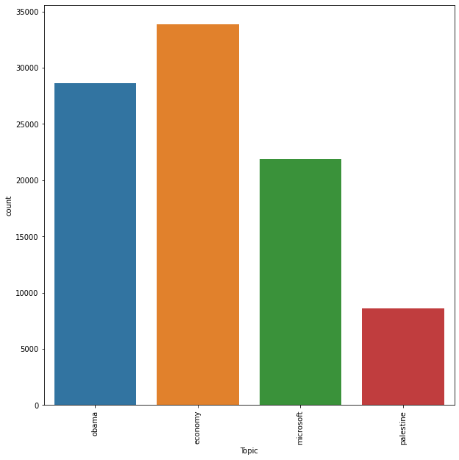
The EDA

Slide 6
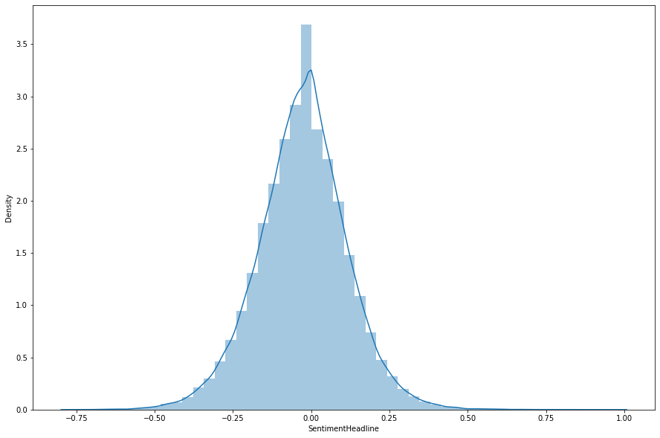
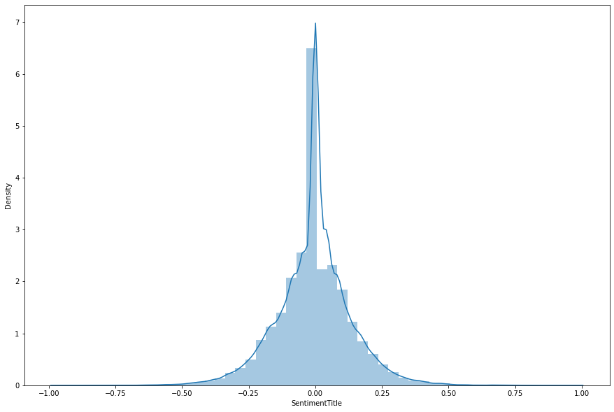
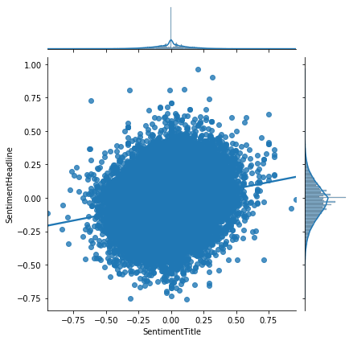
The EDA(Continue)

Slide 7
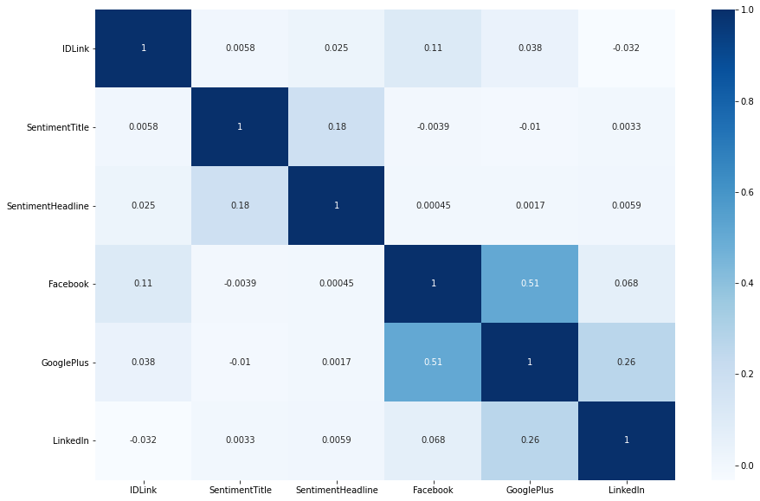
The EDA (Continue)

Slide 8
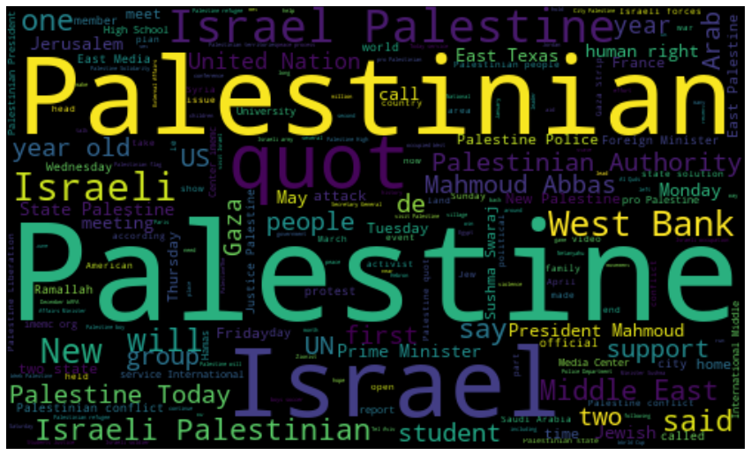
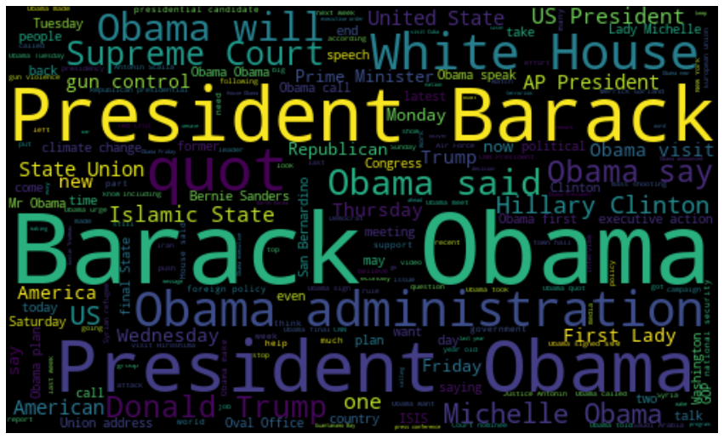

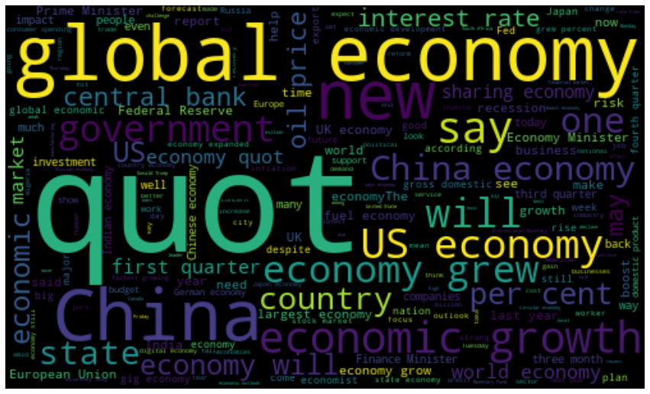
The EDA(Continue)
Obama
Palestine
Microsoft
Economy

Slide 9
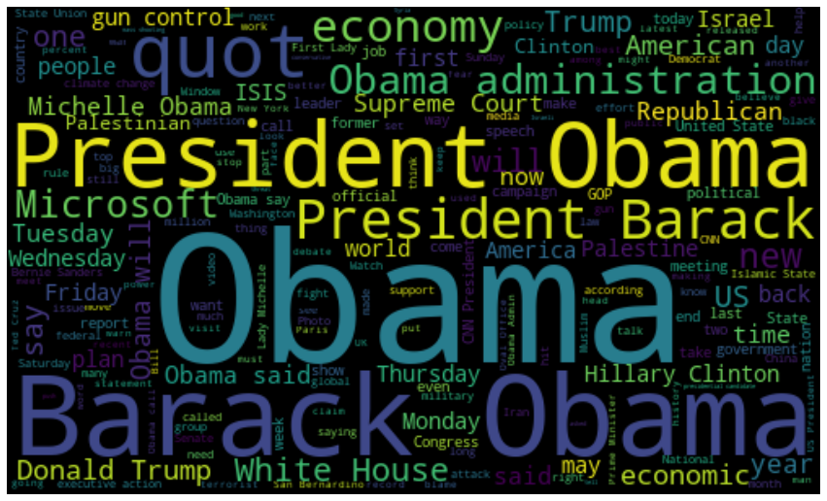
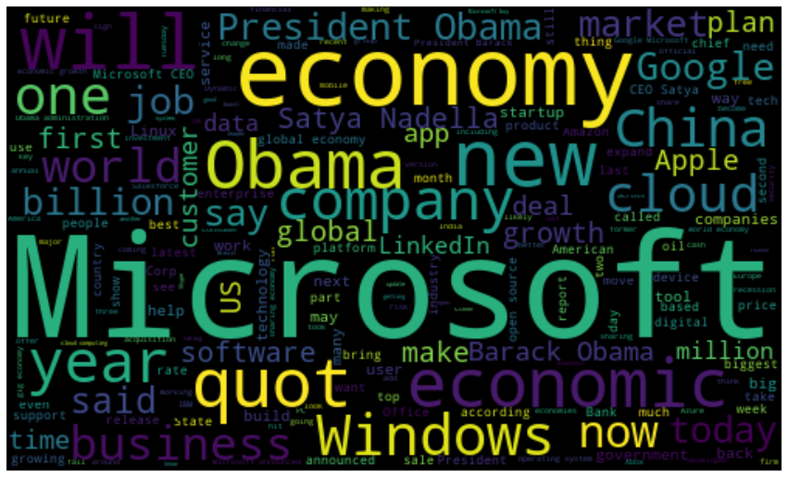
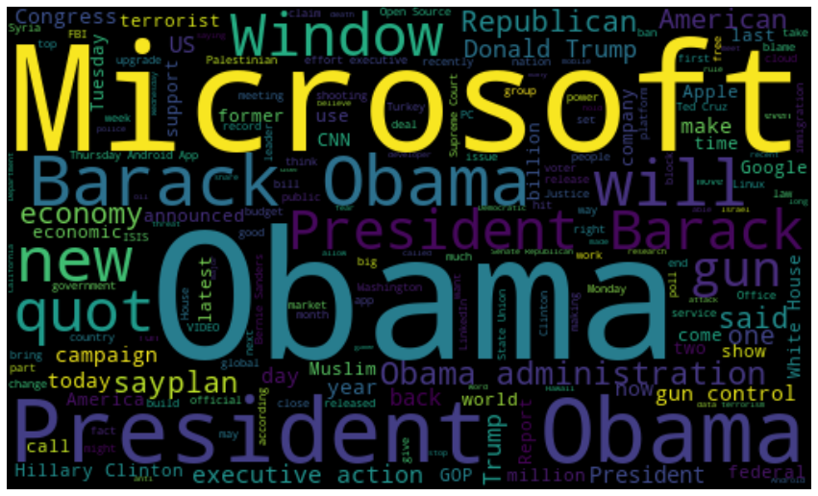
The EDA(Continue)
FB
Social
Media
LI
GP
News With 100+ likes On Social Media

Slide 10

Text Processing
Tokenization.
Remove punctuations.
Remove stopwords.
Remove short words.
Lemmatization.
Stemming.
N-grams.
TF-IDF Vectorizer.

Slide 11

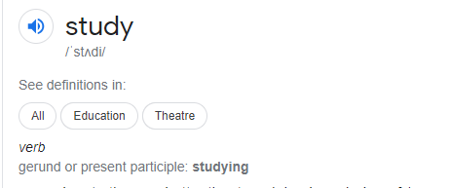
Text Processing(Continue)
The Lemmatization : Lemmatization (lemmatization) in linguistic is the process of grouping together the inflected forms of a word so they can be analysed as a single item, identified by the word's lemma, or dictionary form.

Slide 12
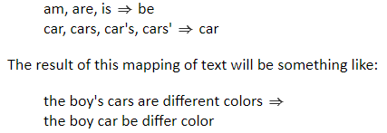
Text Processing(Continue)
Stemming : Stemming is the process of producing morphological variants of a root/base word. Stemming programs are commonly referred to as stemming algorithms or stemmers. A stemming algorithm reduces the words “chocolates”, “chocolatey”, “choco” to the root word, “chocolate” and “retrieval”, “retrieved”, “retrieves” reduce to the stem “retrieve”.

Slide 13
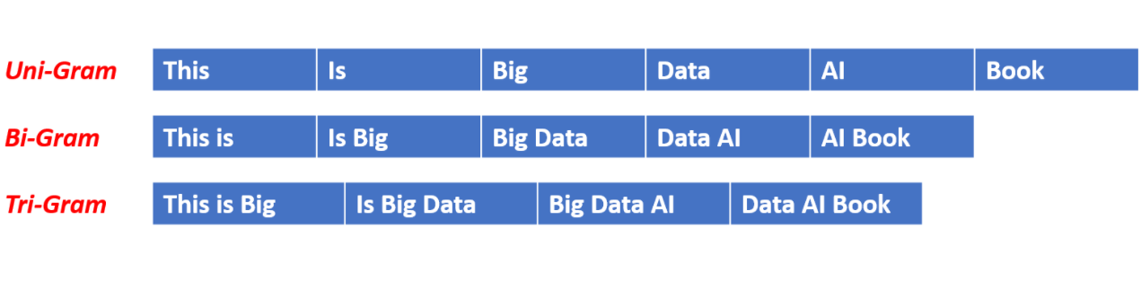
Text Processing(Continue)
Ngram: An n-gram model is a type of probabilistic language model for predicting the next item in such a sequence

Slide 14
Text Processing(continued)
Max features:- Build a vocabulary that only consider the top max_features ordered by term frequency across the corpus.
Ie.If max_feature = n; It means that it is selecting the top n Feature on the basis of Tf-Idf value
Tf_idf We also experimented with changing min_df , and maxdf , which represent the minimum or maximum document frequencies of a word in order to be included as a feature. Empirically, we found that model performance was not very sensitive to the min_df and max_df parameters. In our analysis, we set min_df = 5, max_df = 80%.

Slide 15
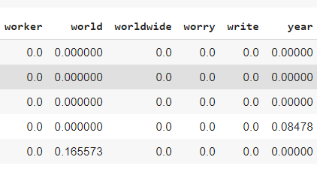
Preparing Dataset
d
Data Partition (80% -Train data 20%-Test Data)
Basic Model Evaluation
MSE is 422126.03507856163
RMSE is 649.7122709927538
r2 score is 0.1594327118754868
MAE is 277.9330093781675

Slide 16
Model Evaluation
RandomForestRegressor
bootstrap=True, ccp_alpha=0.0, criterion='mse',
max_depth=11, max_features='auto',
max_leaf_nodes=None,max_samples=None,
min_impurity_decrease=0.0,
min_impurity_split=None, min_samples_leaf=60,
min_samples_split=50,
min_weight_fraction_leaf=0.0,
n_estimators=120, n_jobs=None, oob_score=False,
random_state=None, verbose=0, warm_start=False
XGBRegressor
base_score=0.5, booster='gbtree', colsample_bylevel=1, colsample_bynode=1, colsample_bytree=1, gamma=0, importance_type='gain', learning_rate=0.1, max_delta_step=0,max_dept=, min_child_weight=1, missing=None, n_estimators=100, n_jobs=1, nthread=None, objective='reg:linear', random_state=0, reg_alpha=0, reg_lambda=1, scale_pos_weight=1, seed=None, silent=None

Slide 17
Future Work
Complexity Measures
Natural Language Features We also added features for the counts of each part of speech using spaCy. We also added average sentence length, number of sentences, and average word length to our features array.
Embedding Matrix
The concept of an embedding matrix is an attempt to solve this relationship representation problem. To begin with, we pick a dimensionality of meaning — this can be somewhat arbitrary. Say we decide all meaning can map to some abstract space of three dimensions. Conceptually, that would mean that all words would exist as singular points in a 3D space and any word could be uniquely defined by their position within that space described by three numbers (x, y, z).

Slide 18
Conclusion
We could conclude that if sentiment value is highly positive then the popularity of that new is high same goes for low sentiment value.
If news contain certain kinds of words like growth, Fear, Danger, Government,business then our sentiment goes either positive or negative.

Slide 19
Challenges
We have 3 dependent variables(Facebook, Google Plus,LinkedIn)
We have a huge data set (it consists of 12 dataset which contain the information of likes of each topic on the given social media platform.)
To implement TF-IDF vectorizer on corpus of having 100000 news document.
Google Colab Crash problem.
We do not know how to tackle this type of problem.

Slide 20
Q & A

